Slide 1
Flat Clustering
Karteek pittala
Ramakant khandel
Sagar thakur

Slide 2
Clustering and Unsupervised Learning
Clustering algorithms group a set of documents into clusters or subsets.
Goal is to create clusters that are coherent internally but different from each other.
Clustering is a form of unsupervised learning.
Unsupervised means there is no human expert who assigns documents to classes.
Clustering and Classification are two different things and the latter is a part of supervised learning.

Slide 3
Unsupervised Learning and Flat Clustering
Input to a clustering algorithm is the distance measure. (For eg: Euclidean distance)
Different distance measures give rise to different clusterings.
It is an important measure on which clustering depends upon.
Flat clustering creates a flat set of clusters without any explicit structure that relates clusters to each other.
Example of a flat clustering algorithm is K-means.

Slide 4
Hard and Soft Clustering
In hard clustering, each document is a member of exactly one cluster. Hence, it has a hard assignment.
In soft clustering, assignment of a document is a distribution over all clusters and a document has fractional membership in several clusters. Hence, it has a soft assignment.
Example of a soft clustering algorithm is Latent semantic indexing which is a form of dimensionality reduction, Expectation-Maximization algorithm.
Example of a hard clustering algorithm is K-means.

Slide 5
Cluster Hypothesis
Cluster Hypothesis states the fundamental assumption we make when using clustering algorithms.
Eg:-With respect to relevance to information needs, documents in the same cluster behave in a similar fashion.
The above hypothesis means that if a document in a cluster is relevant to a search request, then there is a possibility that the other documents from the same cluster are also relevant.

Slide 6
Applications of Clustering in IR
Search Result Clustering
Scatter-Gather
Collection Clustering
Language modelling
Cluster based retrieval

Slide 7
Search Result Clustering
What is clustered?
Search Results
Search results mean the documents that were returned in response to a query.
The default representation is a list.
Benefit?
More effective information presentation to user.
User will not have to scan all documents of every cluster but only the documents which are in the same cluster.
This is very useful if a search term has different word senses.

Slide 8
Scatter-Gather
What is clustered?
Subsets of collection
Scatter-Gather clusters the whole collection to get groups of documents that the user can select or gather.
Basically, the groups which are selected are merged and result set is again clustered.
This entire process is repeated until the cluster of interest is found.
Benefit?
Beneficial in scenarios where users prefer browsing over searching because they are unsure about which search terms to use.

Slide 9
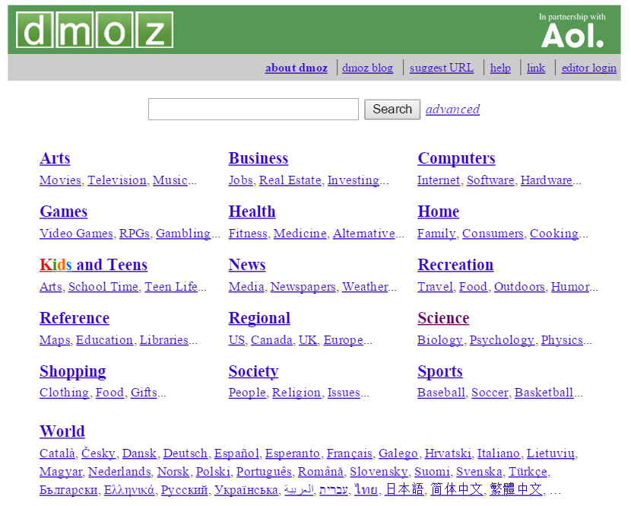
Scatter-Gather (Cont’d)

Slide 10
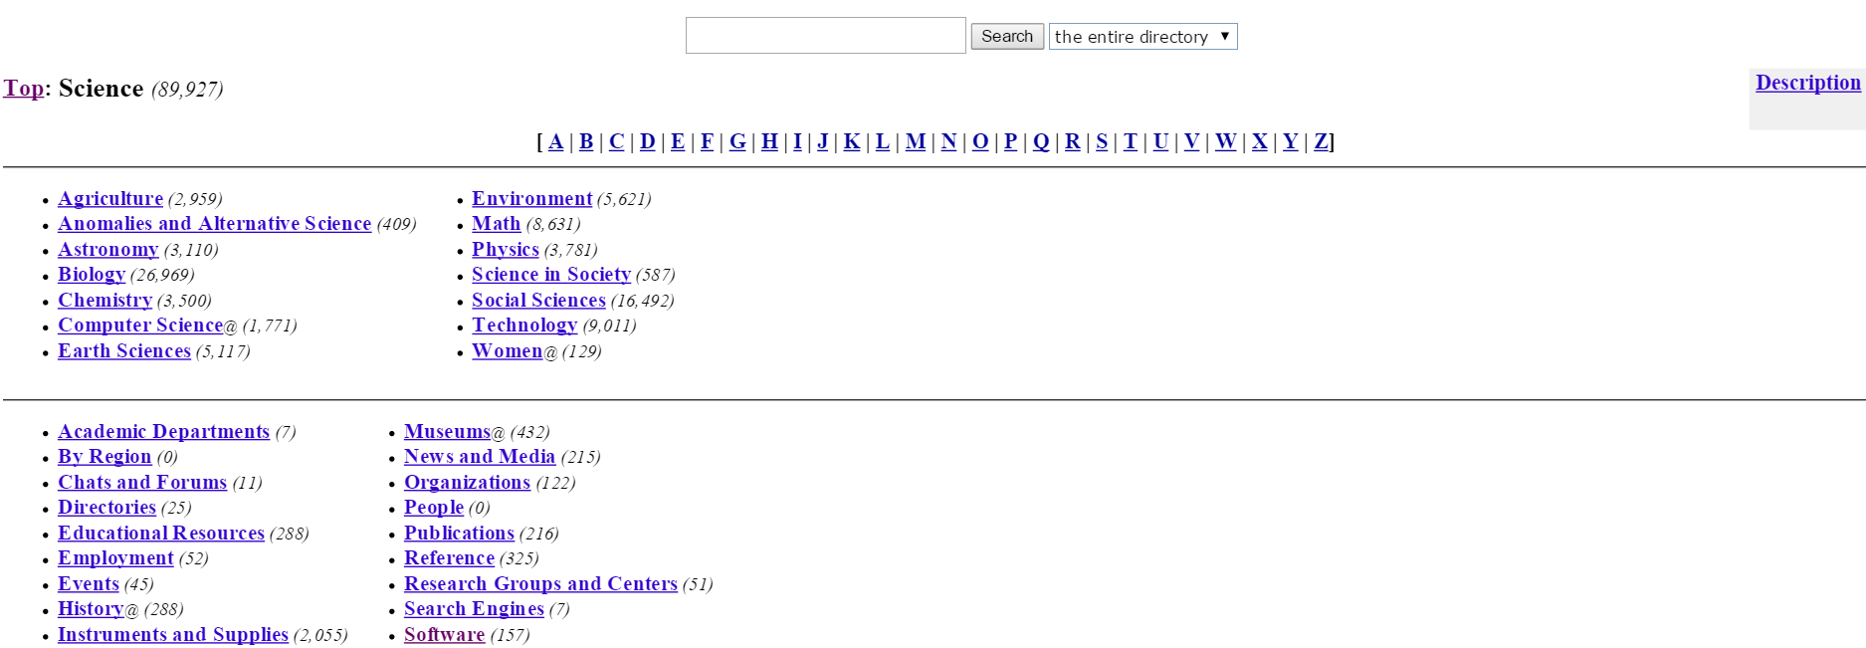
Scatter-Gather (Cont’d)

Slide 11
Collection Clustering
What is clustered?
Collection
This is an alternative to Scatter-Gather which has user-mediated iterative clustering.
One way of doing collective clustering can be static hierarchical clustering of a collection that is not influenced by user interactions is computed.
Example is Google News, Yahoo! News
Since news reading is not really search, clustering is well suited for access to a collection of news stories.
Benefit is effective information presentation for exploratory browsing.

Slide 12
Language modelling
What is clustered?
Collection
For improving search results, language modelling exploits the cluster hypothesis directly based on clustering of the entire collection.
A standard inverted index to identify an initial set of documents that match the query is used but other documents which have low similarity to the query are also added from the same clusters.
Benefit?
This can increase recall since a group of documents with high mutual similarity is often relevant as a whole.

Slide 13
Objective function
Consider the following problem statement where a goal in hard flat clustering is defined:
Given 1. A set of documents D = {d1, … , dN},
2. A desired number of clusters K and
3. An objective function that evaluates the quality of clustering, we want to compute a task Ɣ : D → {1, … , K} that minimizes (or maximizes) the objective function.
The objective function is often defined in terms of similarity or distance between documents.

Slide 14
Terminology
Partitional clustering: It refers to a clustering where each document belongs to exactly one cluster. But in a partitional hierarchical clustering all members of a cluster are also members of their parent.
Exhaustive: In exhaustive clusterings each document is assigned to a cluster whereas in non-exhaustive clusterings there will be some documents which are not assigned to any cluster.
Exclusive: Non-exhaustive clusterings in which each document is a member of either no cluster or one cluster are called Exclusive.

Slide 15
Cardinality – the number of clusters
Finding cardinality is a difficult issue in clustering.
Cardinality is denoted by ‘K’ which is often a good guess based on experience or domain knowledge.
But for K-means, there is also a heuristic method which is involved for selecting ‘K’ and an attempt to incorporate the selection of K into the objective function.

Slide 16
Evaluation of clustering
Internal criteria of quality: Typical objective functions in clustering formalize the goal to attain high intra-cluster similarity since documents within a cluster are similar and low inter-cluster similarity since documents from different clusters are dissimilar.
Good scores on internal criteria not necessarily translate into good effectiveness in an application.
Alternative to this is direct evaluation in the application of interest.
External criteria of quality: A set of classes in an evaluation benchmark or gold standard can be used.
Gold standard is produced by human judges with a good level of inter-judge agreement.

Slide 17
Evaluation (Cont’d)
There are four other external criteria of clustering quality:-
1. Purity – simple and transparent evaluation measure.
2. Normalized mutual information – information-theoretically interpreted.
3. Rand index – It measures the percentage of decisions that are correct. It penalizes both false positive and false negative decisions during clustering.
4. F measure – supports differential weighting of these two types of errors.

Slide 18

Purity
Each cluster is assigned to the class which is most frequent in the cluster and then the accuracy of this assignment is measured by counting the number of correctly assigned documents and dividing by N.
Purity(Ω, С) = 1/N $\sum_{k}{\max_{j}|ω_{k} ∩c_{j}|}$
where Ω = {$ω_{1}$, $ω_{2}$, … , $ω_{k}$} is the set of clusters and
С = {$c_{1}$, $c_{2}$, … , $c_{j}$} is the set of classes
$ω_{k}$ is the set of documents in $ω_{k}$ and $c_{j}$ is the set of documents in $c_{j}$.
Bad clustering have purity values close to 0 whereas perfect clustering have purity value of 1.
High purity is easy to achieve when the number of clusters is large – in particular, purity is 1 if each document gets its own cluster.
Thus we cannot use purity to trade off the quality of the clustering against the number of clusters.

Slide 19
K-means
It is the most important flat clustering algorithm.
Its objective is to minimize the distance of document from their cluster centroid.
RSS(Residual Sum of Squares) is one of the distance function.
K-means converges as RSS decreases in each iteration.
The convergence of K-means does not guarantee that a global minimum has reached.
Time complexity(O(IKNM))

Slide 20
Termination Condition
Number of Iteration I has been completed.
Assignment of documents to clusters does not change between iterations.
Centroids to not change between iterations.
Terminate when RSS falls below a threshold.

Slide 21
Outlier
Outlier is chosen as an initial seed, then no other vector is assigned to it during subsequent iterations.(a cluster with only one document)
This leads to clustering with higher RSS compared to clustering with lower RSS.

Slide 22
Heuristics for seed selection
Excluding outliers from seed set.
Trying out multiple starting points and choosing the cluster with lowest cost.

Slide 23
Cluster cardinality of K-means
Number of cluster, K is an input to most flat clustering algorithms. Estimate the value of k.
A naïve approach is to select the optimal value of k according to an objective function that minimizes the value of RSS.
RSSmin(K) is 0 when K = N
N – number of documents

Slide 24
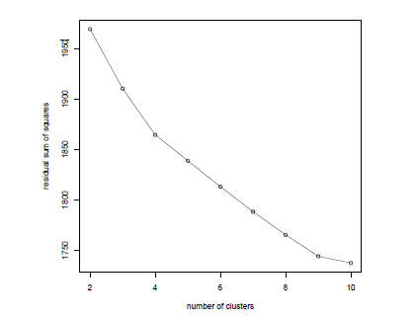
Estimated minimal residual sum of squares as a function of the number of clusters in K-means. In this clustering of 1203 Reuters-RCV1 documents, there are two points where the dRSSmin curve flattens: at 4 clusters and at 9 clusters. The documents were selected from the categories China, Germany, Russia and Sports, so the K = 4 clustering is closest to the Reuters classification.

Slide 25
Second type of cluster cardinality imposes a penalty for each cluster.
We start with a single cluster containing all documents and then search for the optimal K, by successively incrementing 1.
To determine, cluster cardinality, use two objective functions
Distortion – measure of how much the documents deviate from the prototype of their clusters
Model complexity

Slide 26

Selection criterion for K:
where λ is a weighting factor. A large value of λ favors solutions with few clusters. For λ = 0, there is no penalty for more clusters and K = N is the best solution
Need to determine λ.
Hard to predict the value of λ, we can choose values of λ, that generated best values for k in the past.

Slide 27

AIC( Akaike information Crtiterion), provides a theoretical justification for distortion and model complexity.
General form of AIC
Reasons for using AIC
First property of good model of data, each data point is modelled well by the model, and the goal of low distortion.
Model should be small, since a model that describes only the data is worthless.
Derivation of AIC is based on a number of assumptions, that the data are independent and identically distributed.
These assumptions are approximately true for data sets in information retrieval.

Slide 28
Model based clustering
It can be applied to a larger variety of document representations and distributions than K-means
Generating a document in this model consists of first picking a centroid and then adding some noise.
Model based clustering assumes that the data were generated by a model and tries to recover the data from the model.
In K-means, the quantity exp(-RSS) is proportional to the likelihood that a model( set of centroids) generated the data
Select the parameter, θ that maximizes the likelihood of generating a particular doc given a set of documents. Once we can have θ, we can compute the assignment probability P(d|wk; θ) for each document-cluster pair. This assignment probabilities is soft clustering.

Slide 29
Model based clustering provides a framework for incorporating knowledge about a domian.
Model based clustering offerings more flexibility
A commonly used algorithm for model based algorithm is the Expectation Maximization algorithm.
EM clustering is an iterative algorithm.
To generate the model, we first pick a cluster k with probability k and then generating the terms of the document according to parameters qmk.

Slide 30
Similar to K-means, EM alternates between expectation step and maximization step. Maximization step recomputes the conditional parameters and maximization step, for recomputation of the parameters qmk and ak.
Limitations
Finding good seeds is more critical for EM than for K-means
EM is prone to get stuck in local optima if the seeds are not chosen well.
An approach to this, the initial assignment of documents to clusters is often computed by different algorithm.

